Slide 1
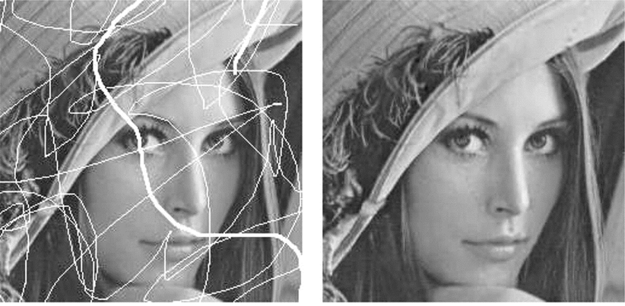
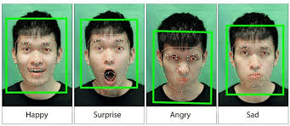
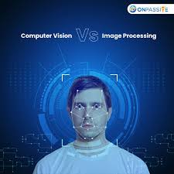
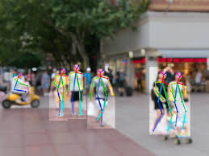

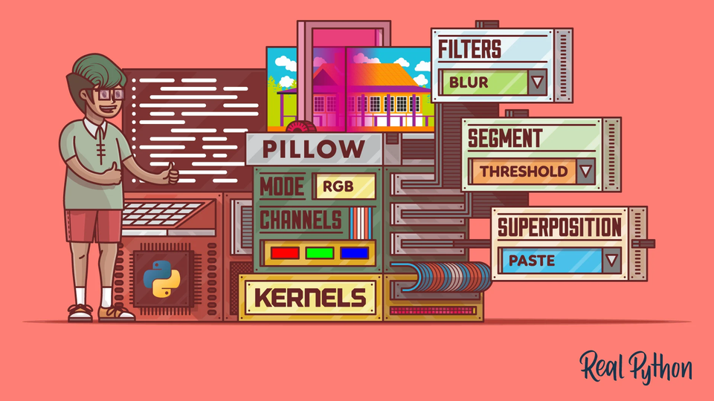
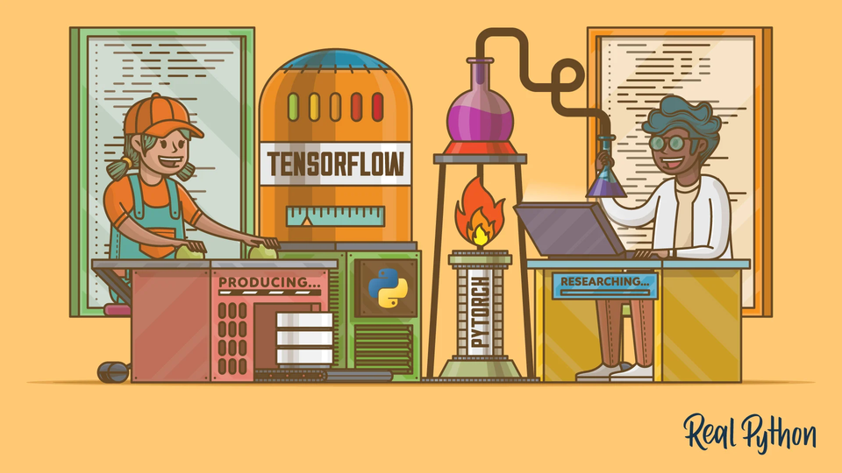

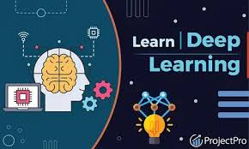
INTEL UNNATI PROGRAM
Detect Pixelated Image and Correct It

Slide 2

PROBLEM STATEMENT
PART 1 -
Given an Image, check if it is blocky or pixelated. Pixilation means blurry, blocky squares you see when an image is zoomed too much. Design an algorithm that can detect whether the image is pixelated or not. The challenge is to design an algorithm or ML/AI model, which is extremely lightweight or computationally efficient such that we can run this algorithm at 60 Hz or 60 frames per sec (FPS) and must be minimum 90% accurate. The pixelated images are rare and hence the algorithm should not create too many false positives. Algorithm / model quality will be measured by F1-score, precision recall curve etc.

Slide 3
DESCRIPTION
PART 1 -
Also, the algorithm should be able to work on 1080p resolution input with same performance. It is ok to downscale the large image to any desired input size to work on large images.
a. Input Image Size: 1920x1080 (it’s ok to downscale and feed into the algorithm/model).
b. Inference Speed Target: Min 30Hz, better to have 60 Hz.
c. Accuracy Metric: F1 Score/Precision Recall.
d. Should work in rare class scenario: if only one in 1000 images are pixelated then the algorithm must predict at most 10% False Positives.

Slide 4
DESCRIPTION
PART 2 -
Given a pixelated image, design an algorithm to improve the quality of the image i.e., restore the lost information. This problem is also known as jpeg restoration. Here also the challenge is to design a highly efficient algorithm that can run at least at 20 FPS. The quality of restoration can be examined by comparing with ground truth image using any metric like LPIPS, PSNR etc. If a nonpixelated image is given then the algorithm should not enhance it and leave it intact. Algorithm should work on 1080p resolution images.

Slide 5
PRE - REQUISITES
▪ Concepts in Machine Learning - SKLEARN
▪ Programming Skills (Python) - OPENCV , PIL , NUMPY
▪ Deep Learning - Train/Validate/Test with Data

Slide 6
UNIQUE IDEA
This project has a lot of different ideas, and I went with the
"deep learning-based approach."
I developed my model to depixelate the photos using the Super-Resolution Convolutional Neural Network (SRCNN) idea, which is the most practical kind of deep learning. By forecasting related high-resolution (HR) images, the SRCNN model is used to improve the resolution and quality of low-resolution (LR) images. Pairs of LR and HR photos are used to train it.

Slide 7
g
Training: SRCNN is trained on pairs of LR and HR images. During training, it learns to minimize the difference between predicted HR images and ground truth HR images using techniques like gradient descent.
Advantages: SRCNN has shown significant improvements in image super-resolution compared to traditional methods. It's capable of learning complex mappings and producing visually appealing results.
Applications: It's widely used in applications where enhancing image resolution is crucial, such as medical imaging, satellite imagery, and digital photography.

Slide 8
g
FEATURES OFFERED
The features offered by SRCNN (Super-Resolution Convolutional Neural Network) include:
High-Resolution Image Reconstruction: SRCNN excels in reconstructing high-resolution (HR) images from low-resolution (LR) inputs, improving visual quality and detail.
Feature Extraction: Initial layers of SRCNN extract relevant features from LR image patches, which are then processed and reconstructed into HR images in subsequent layers.
Adaptability: The network adapts its parameters during training to minimize differences between predicted HR images and ground truth HR images, optimizing its ability to enhance various types of images.

Slide 9
g
4.Learned Mapping: It learns a complex mapping function between LR and HR images during training, leveraging deep learning techniques to capture intricate details.
5.Non-linear Processing: SRCNN employs multiple layers of convolutional neural networks (CNNs) to perform non-linear processing on image patches, enabling it to handle diverse image characteristics and textures effectively.
6.Quality Metrics Improvement: Beyond PSNR and SSIM, advanced variants of SRCNN aim to improve perceptual quality metrics by considering human visual perception factors, enhancing the realism and natural appearance of enhanced images.

Slide 10
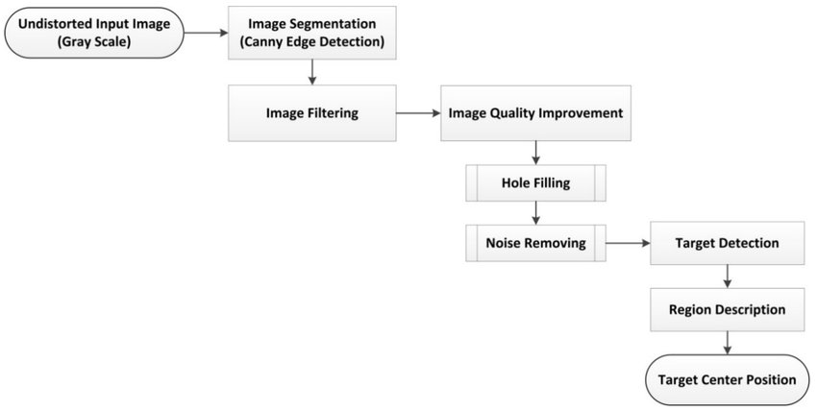
PROCESS FLOW
PART 1-

Slide 11
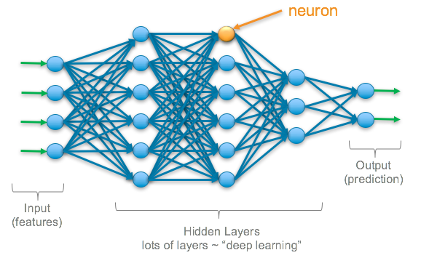
PROCESS FLOW
PART 2-

Slide 12
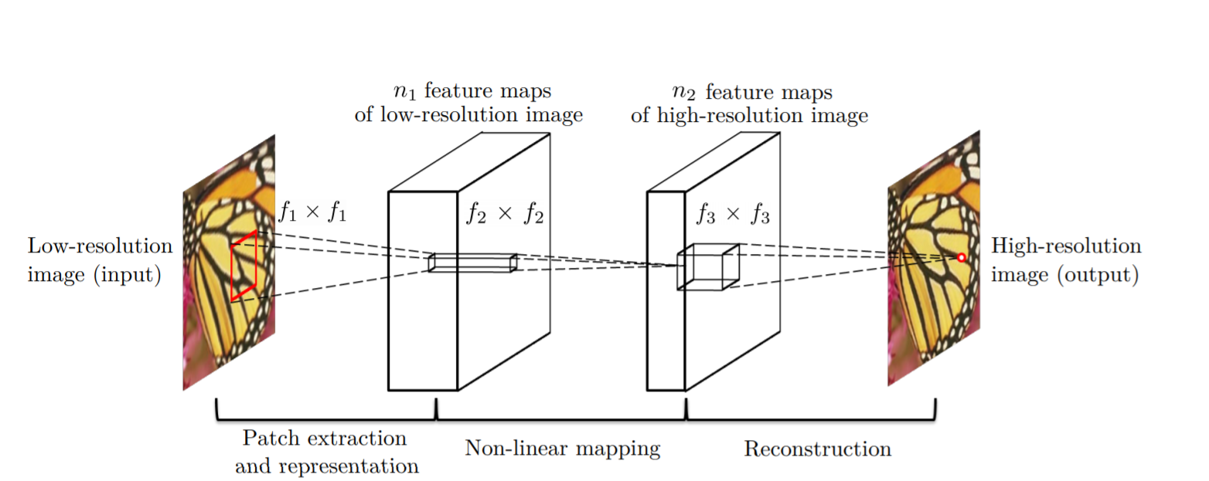
ARCHITECTURE DIAGRAM

Slide 13
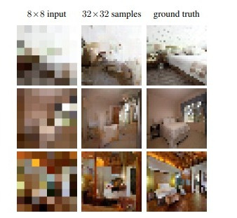
CHALLENGES
Some of the problems of this study include developing a novel probabilistic deep network architecture, the pixel recursive super resolution model, and overcoming the challenge of super resolution when increasing low-resolution photos to high-resolution ones. The model is made up of a conditioning network and a previous network, which are trained using Super-Resolution Convolutional Neural Network.
Reference - https://arxiv.org/pdf/1702.00783

Slide 14
TECHNOLOGIES USED
Python Libraries that used are :-
Opencv - Open Source Computer Vision Library is an open-source computer vision and machine learning software library. It is designed for real-time computer vision applications and is widely used for a variety of tasks such as image processing, object detection, video analysis, and more.
PIL - PIL stands for Python Imaging Library. It is a library in Python that adds support for opening, manipulating, and saving many different image file formats.
Scikit-learn - It is a popular machine learning library for Python that

Slide 15
provides a wide range of tools for building and applying various machine learning algorithms.
Tensorflow- TensorFlow is a free and open-source software library for machine learning and artificial intelligence.It is designed to facilitate the development and deployment of machine learning models, particularly neural networks, for a wide range of tasks.
Concept use is :
SRCNN- It stands for Super-Resolution Convolutional Neural Network. It is a deep learning model specifically designed for the task of single-image

Slide 16
super-resolution, which aims to enhance the resolution and quality of low-resolution images.
We also saw the concept of :-
Convolutional neural networks (CNNs) - CNNs are used for image recognition and processing. They are particularly good at identifying objects in images, even when those objects are partially obscured or distorted.

Slide 17
CONCLUSION
This project gives an idea of image processing, where we find an image pixelated or not, and if it is pixelated, we correct it by using deep learning models. In this project, we've explored robust methods of deep learning models like CNN and SRCNN that are especially used for enhancing images. underscore the efficacy of these approaches in enhancing the images, removing the blurriness of the image, de-pixelating the image, and paving the way for applications in diverse fields with promising avenues for future advancements.

Slide 18

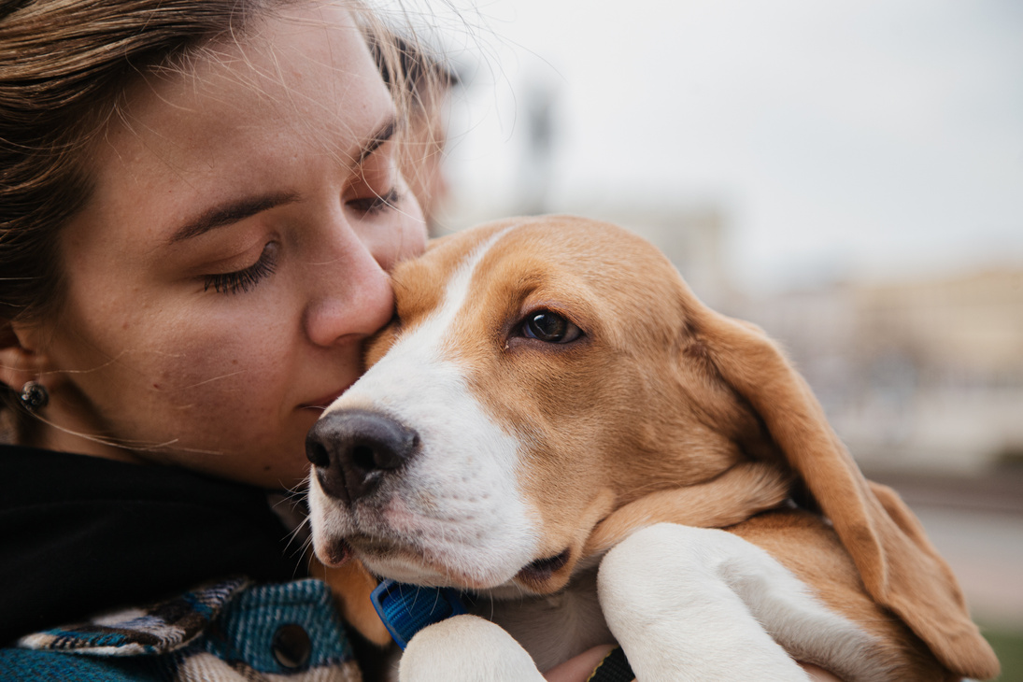
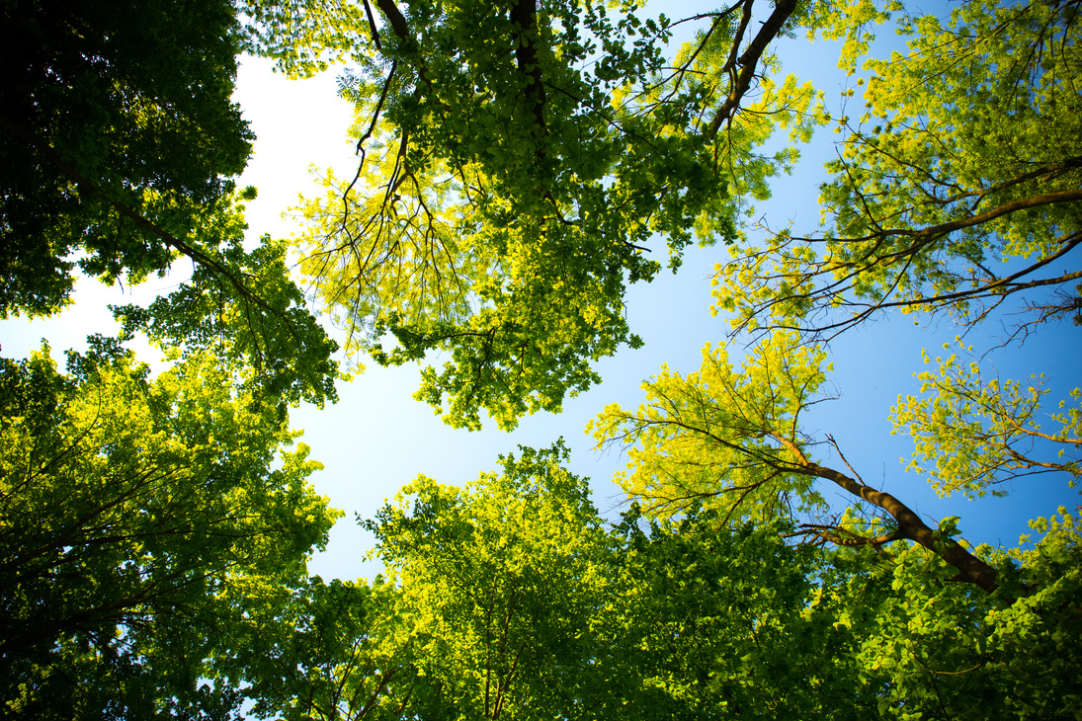

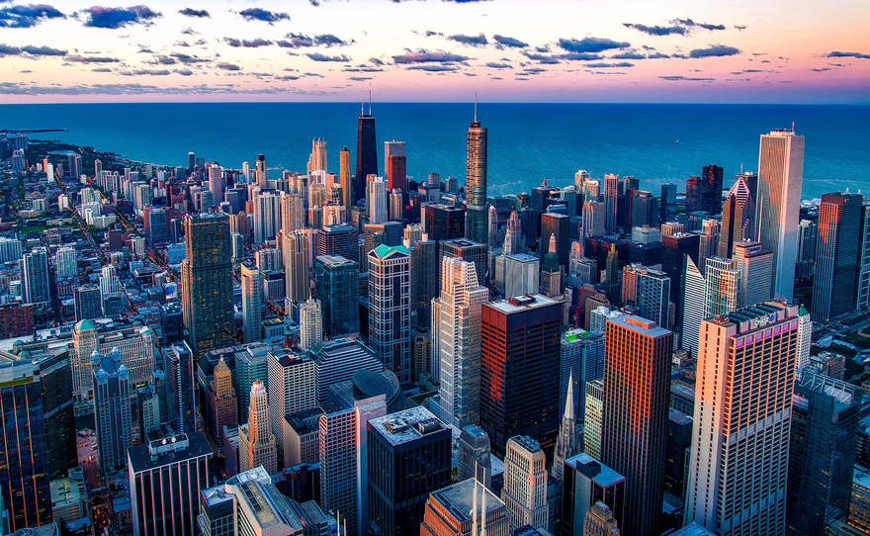
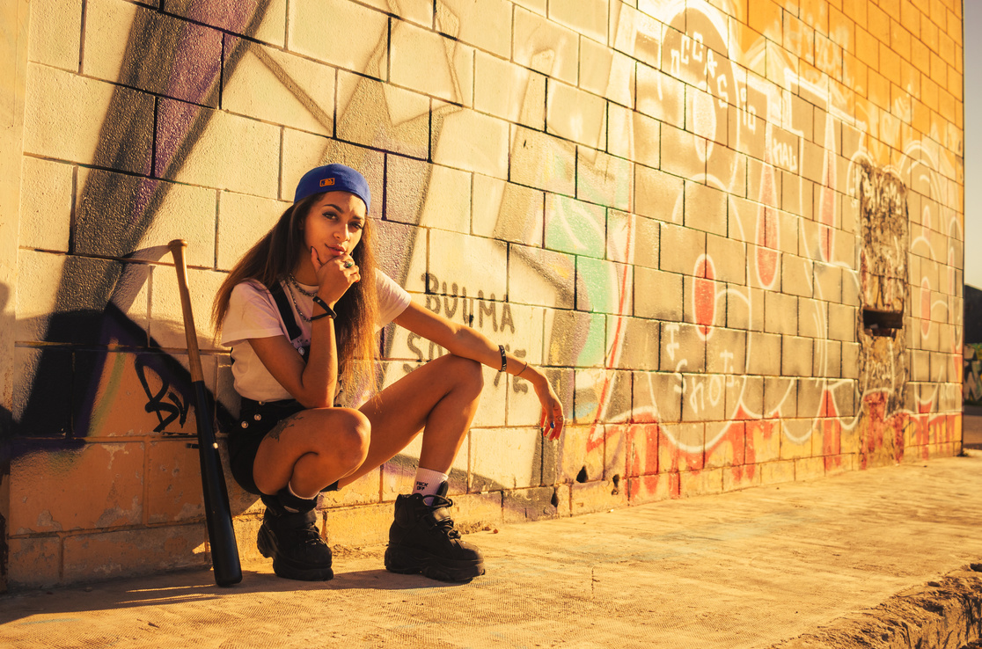


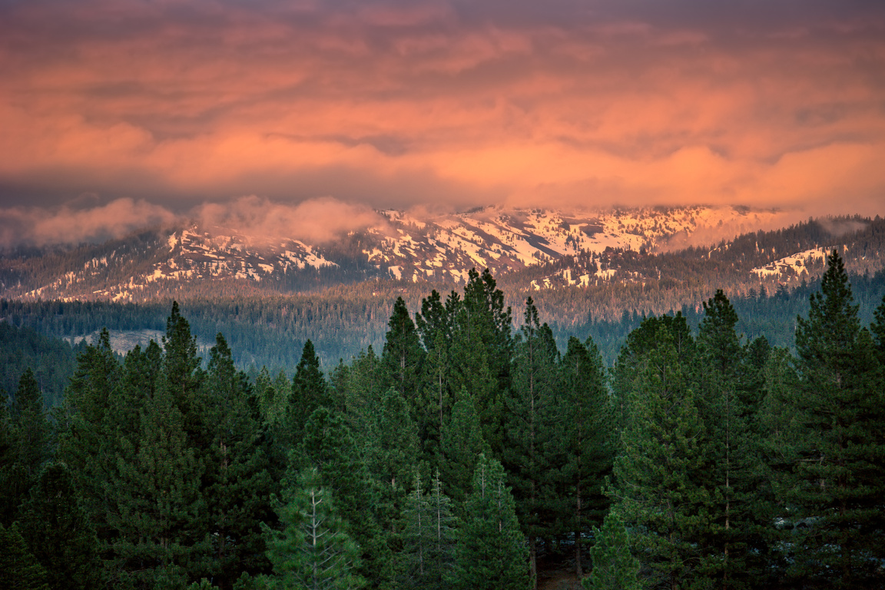
THATS A WRAP!
THANK YOU !
Presented by - Prerita Saini
B.tech Honours (CS)
GLA UNIVERSITY

